Slide 1
Brain tumor classification and segmentation using deep learning
BENSON BABY THOMAS
SID:2190563

Slide 2
Introduction
Brain tumors are abnormal growths of tissue in the brain,posing significant health risks.
Accurate and fast diagnosis and segmentation of brain tumors is challenging due to variations in types, sizes, and locations, along with overlapping symptoms.
Deep learning, particularly convolutional neural networks (CNNs), offers a promising solution for precise and efficient tumor classification and segmentation.

Slide 3
AIM and Objective
Comparative Study: Evaluate the effectiveness of CNN models (VGG19, EfficientNetB0, InceptionV3, MobileNetV2, DenseNet121) in classifying glioma, meningioma, pituitary tumors, and no-tumor cases.
Segmentation: Utilize the U-Net architecture for precise tumor segmentation, providing detailed boundary information for improved treatment planning.

Slide 4
Background study
In the study by A. G, H. T. J, A. J, A. Bhanu, and N. Ig (2023), the authors employ deep learning models, including ResNet50 and Xception architectures, to classify brain tumors with high accuracy rates of 98.02% and 98.32%, respectively, using MRI scans. This approach underlines the critical role of convolutional neural networks in enhancing the early detection and precise classification of brain tumors, contributing significantly to advancements in medical imaging technologies.
P. M, L. A N, M. P, and M. Bharadwaja (2023) develop a specialized convolutional neural network (CNN) for segmenting brain tumors in MRI images, demonstrating enhanced feature extraction and classification accuracy compared to existing models, which significantly advances AI applications in medical diagnostics.

Slide 5
DATA DESCRIPTION

Slide 6
Dataset
For Classification, utilized Publicly available "Brain Tumor MRI Dataset" curated by Msoud Nickparvar (2021) .
Classification dataset comprises 7023 human brain MRI images classified into 4 categories: glioma (1621 images), meningioma (1645 images), no tumor (2000 images), and pituitary (1757 images).
For the segmentation task, the dataset leveraged was the 'Brain Tumor MRI Dataset' assembled by Cheng, Jun in 2017. It encompasses 3,064 T1-weighted contrast-enhanced MRI images, segmented into three categories of brain tumors.
Images of each class are available in axial, coronal, and sagittal dimensions, with each image having different sizes and dimensions for both dataset.

Slide 7
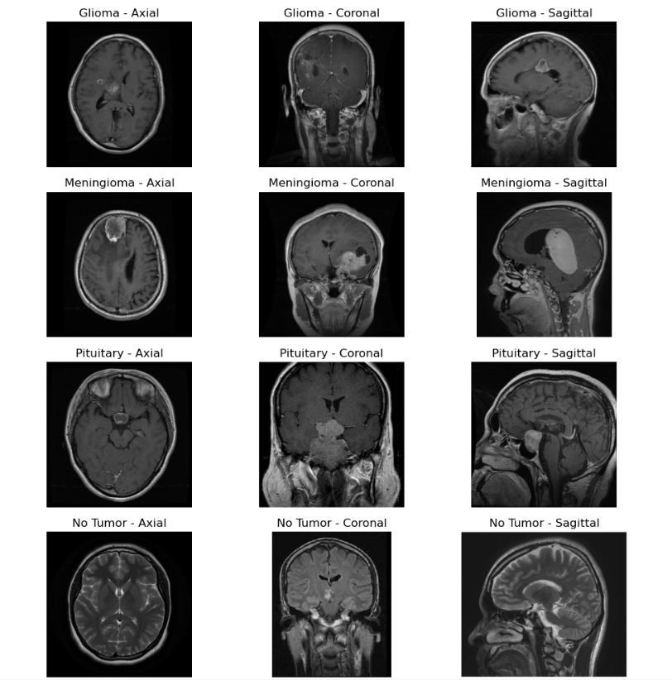
FIGURE 1: CLASSIFICATION DATASET SAMPLE

Slide 8
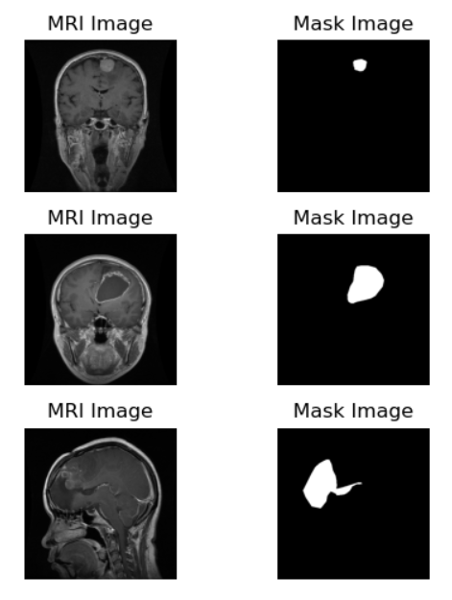
FIGURE 2: SEGMENTATION DATASET SAMPLE

Slide 9
Data Preparation
The dataset was divided into training (70%), validation (15%), and testing (15%) sets.
ImageDataGenerator was employed to preprocess and generate batches of images for training, validation, and testing.
Preprocessing involved applying the default preprocess_input function to all models and image resizing to specific dimensions tailored to each model:
For VGG19, EfficientNetB0, MobileNetV2, and DenseNet121, images were resized to (224, 224) pixels. For InceptionV3, images were resized to (299, 299) pixels.
Data augmentation techniques, such as rotation, shifting, and flipping, were applied to the training set to enhance dataset variability and robustness across all models.

Slide 10
methodology

Slide 11
DEEP LEARNING MODELS
This project utilizes five distinct deep learning models for image classification and the U-Net model for segmentation, each chosen for its unique capabilities.
VGG19: Utilizes a deep architecture for robust image recognition.
MobileNetV2: Designed for speed and efficiency on mobile devices.
DenseNet121: Enhances feature reuse for efficient learning and fewer parameters.
InceptionV3: Optimizes computational efficiency with parallel convolution paths.
EfficientNetB0: Scales efficiently to achieve high accuracy with fewer parameters.
U-Net: Specializes in precise image segmentation by leveraging a unique encoder-decoder architecture.

Slide 12
EfficientnetB0 Model design DESCRIPTION
Base Model Initialization:
Utilizes EfficientNetB0 with pre-trained weights from ImageNet.
Excludes the top classification layers.
Input shape: [Image Width, Image Height, Number of Channels].
Freezing Base Layers:
All base model layers are frozen to retain pre-trained weights and prevent overfitting.
Custom Layer:
GlobalAveragePooling2D layer reduces spatial dimensions.
Dense layer with 256 units and ReLU activation.
Dropout layer with a dropout rate of 0.5 to mitigate overfitting.
Output Dense layer with softmax activation for multi-class classification.
Model Compilation:
Optimized using Adam optimizer.
Loss function set to categorical crossentropy.
Evaluation metric: Accuracy.

Slide 13
U-Net model design description
Contracting Path (Encoder):
Consists of 4 convolutional blocks to extract features and reduce spatial dimensions.
Each block includes two 3x3 convolutional layers with ReLU activation, followed by batch normalization and dropout.
Expansive Path (Decoder):
Comprises 4 transpose convolutional layers to upsample the feature maps and recover spatial information.
Each layer is concatenated with the corresponding feature map from the contracting path to preserve high-resolution details.
Convolutional blocks in the decoder mirror those in the encoder .
Output Layer:
Final convolutional layer with sigmoid activation to generate the binary segmentation mask.
Model Compilation:
Optimized using the Adam optimizer.
Loss function set to binary crossentropy.
Evaluation metric: Accuracy.

Slide 14
Ensemble technique
Combines multiple models to improve the accuracy and robustness of predictions by leveraging the diverse strengths of each individual model.
In this study, I explored two ensemble approaches: one combining all five deep learning models using both hard voting and weighted approaches, and another focusing only on the three top-performing models, also employing hard voting and weighted techniques.

Slide 15
Focus on class method (focM)
In this method, a strategy has been employed to enhance the accuracy of brain tumor classification.
Each model specializes in certain tumor classes, with EfficientNetB0 focusing on glioma and meningioma, while VGG19 and DenseNet121 focus on no tumor and pituitary.
Predictions from these models are combined by prioritizing certain classes and selecting the maximum probability for each tumor type to determine the final classification.
The accuracy of the combined approach is calculated, and a confusion matrix is generated to visualize the model's performance across different tumor classes

Slide 16
Results and evaluation Metrics
In this section, we will review the key metrics used to evaluate the accuracy and effectiveness of our model, including Accuracy, Precision, Recall, and the F1-Score, and discuss their representation in the confusion matrix and classification report.
Accuracy: This metric measures the ratio of correct predictions, including both true positives and true negatives, out of all predictions made.
Precision: This measures the proportion of correct positive predictions relative to all positive predictions made.
Recall: This metric captures how many of the actual positives were correctly identified as positive by the model.
F1-Score: This is a balanced measure that takes into account both precision and recall, providing a single score that balances both aspects.

Slide 17
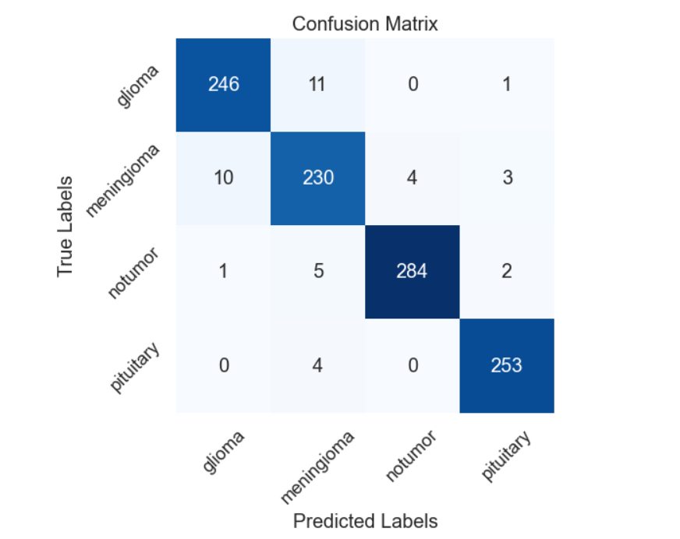
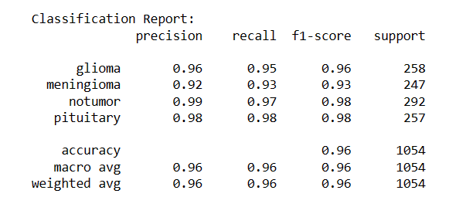
Confusion Matrix and Classification Report of EfficinetNetB0

Slide 18
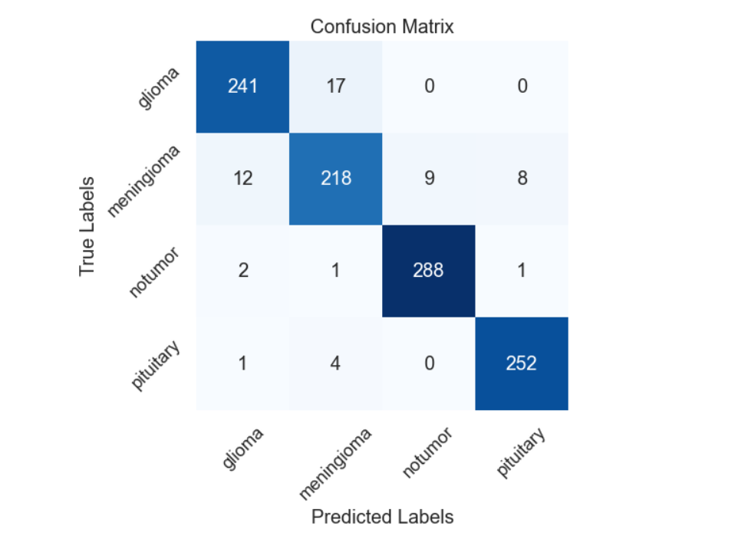
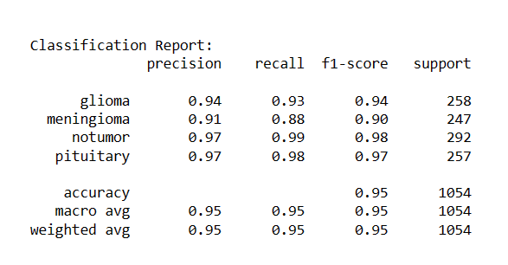
Confusion Matrix and Classification Report of VGG19

Slide 19
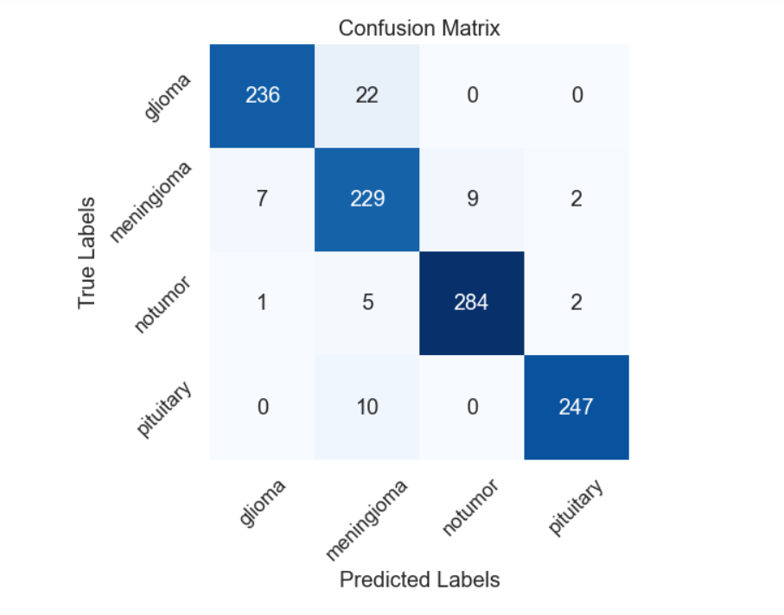
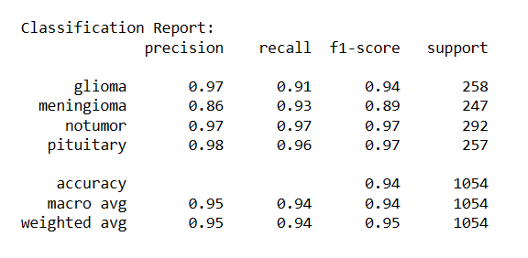
Confusion Matrix and Classification Report of DenseNet121

Slide 20
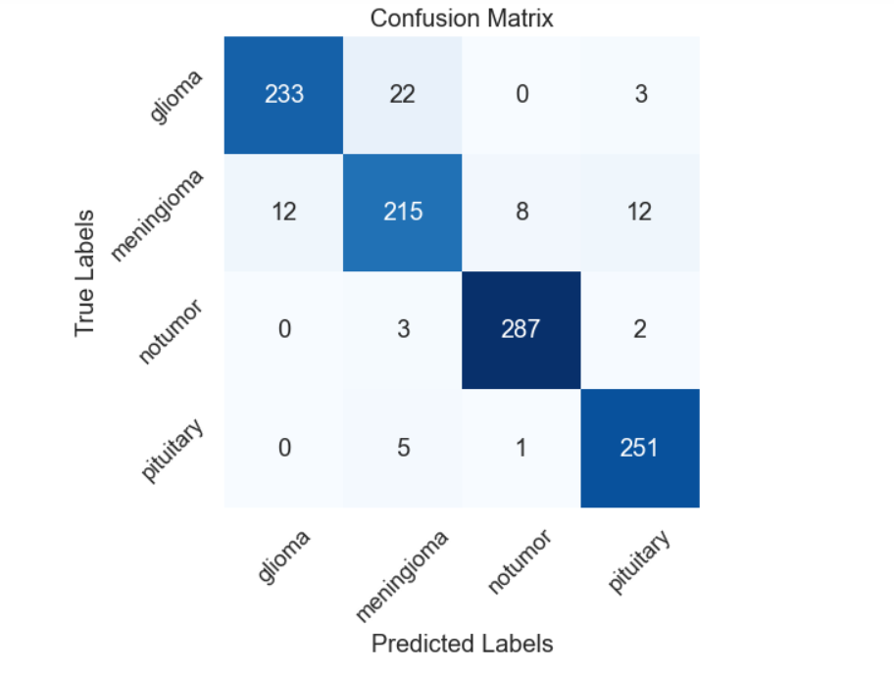
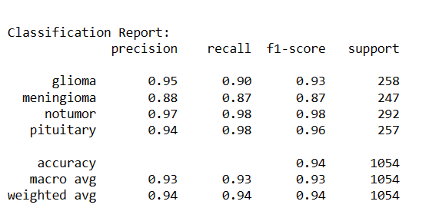
Confusion Matrix and Classification Report of MobileNetV2

Slide 21
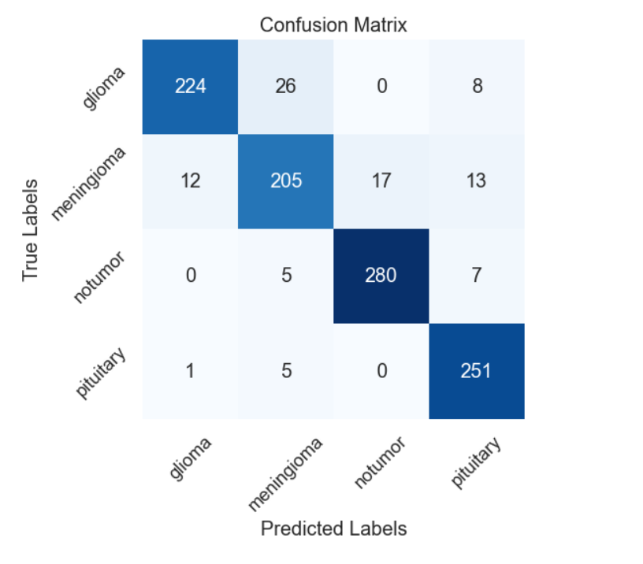
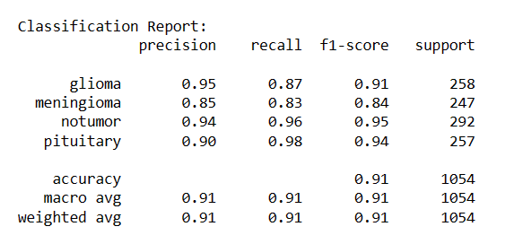
Confusion Matrix and Classification Report of InceptionV3

Slide 22
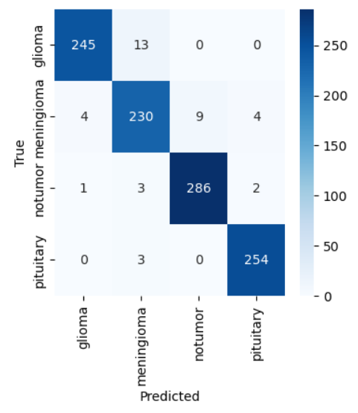
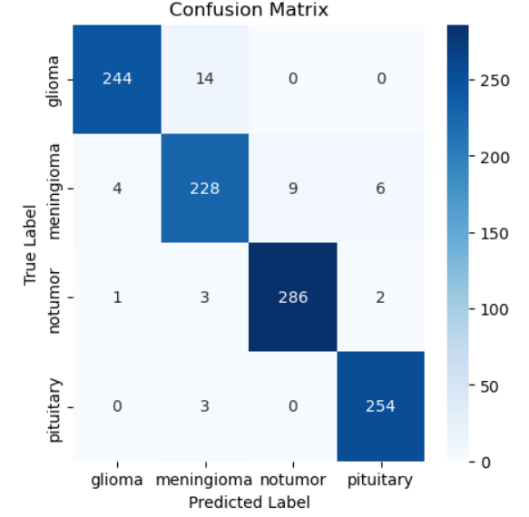
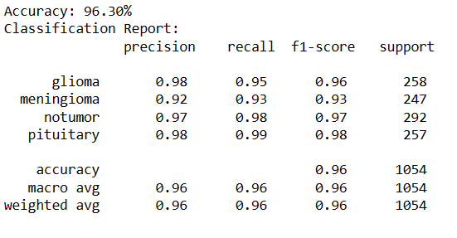
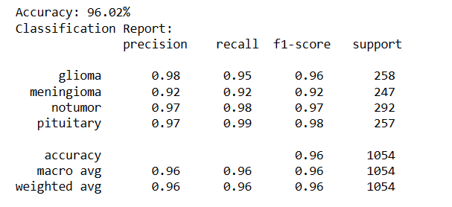
Confusion Matrix and Classification Report for Ensemble of 5 Models
Using Hard Voting and Weighted Methods
Weighted
Hard Voting

Slide 23
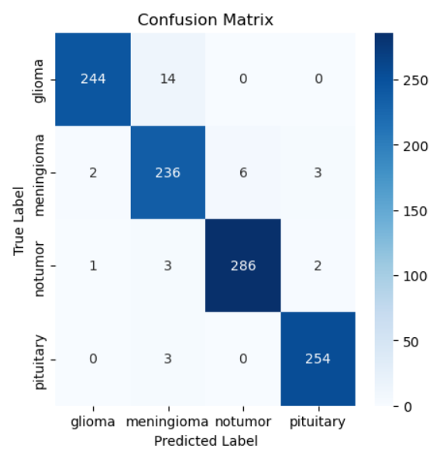
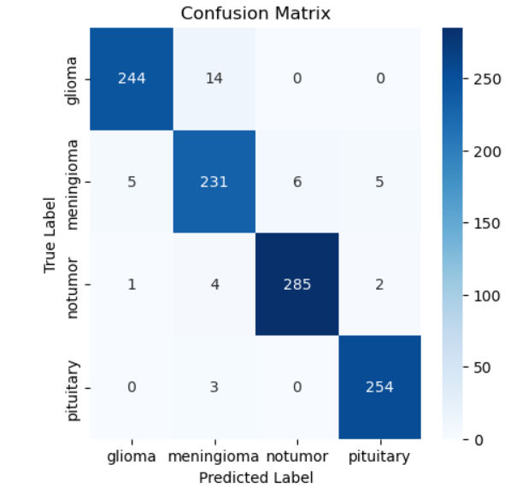
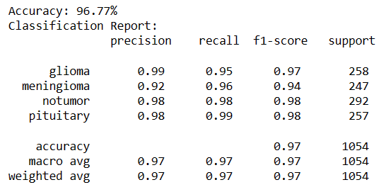
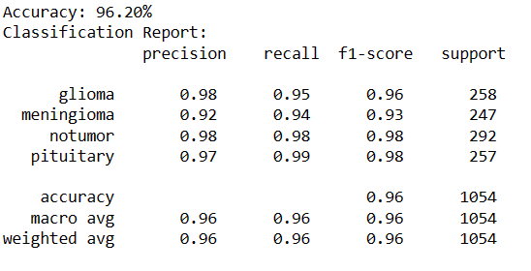
Confusion Matrix and Classification Report for Ensemble of Top 3 Models (EfficinetNetB0,VGG19 and DenseNet121) Using Hard voting and Weighted Methods
Weighted
Hard Voting

Slide 24
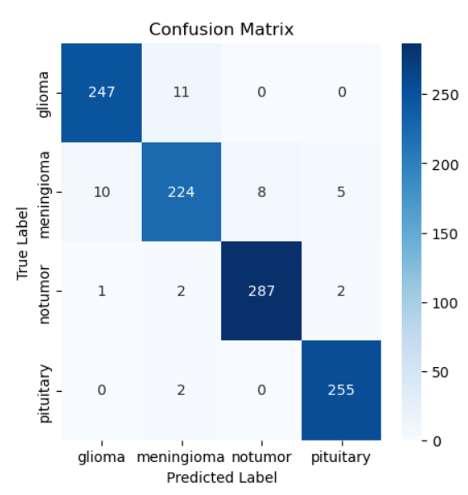
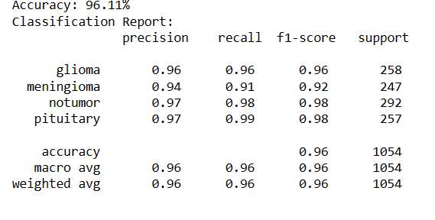
Confusion Matrix and Classification Report for FOC METHOD

Slide 25
U-Net segmentation result
In the U-Net segmentation analysis, a commendable Mean Dice Coefficient of 0.7524 and a Mean IoU of 0.6592 were obtained. These metrics signify the accuracy and effectiveness of the segmentation model in accurately defining brain tumor regions from MRI images.
Dice Coefficient measures the overlap between predicted and ground truth masks, while Mean IoU calculates the average overlap across all masks in the dataset. The coefficient ranges from 0 to 1, where 1 indicates perfect overlap between the masks.

Slide 26
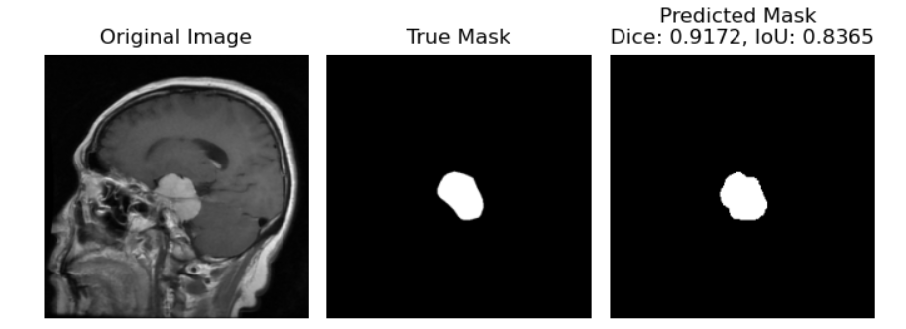
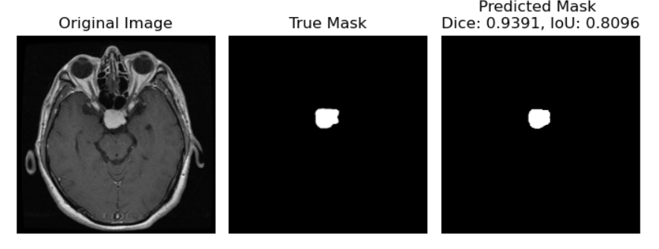
SEGMENTATION RESULT ON TEST SET

Slide 27
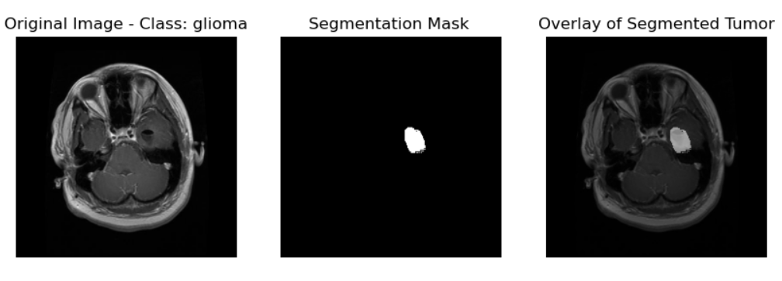
Demo of Final Product: Illustrating Tumor Classification and Segmentation

Slide 28
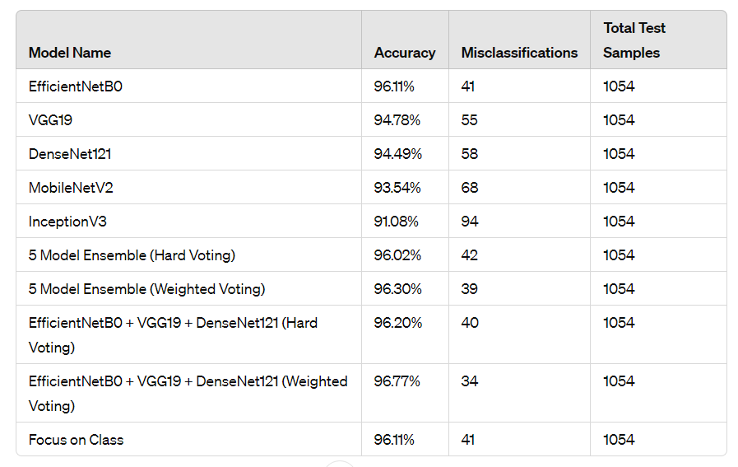
Classification Model Performance Summary

Slide 29
CONCLUSION AND FUTURE WORK
Models demonstrated impressive accuracies ranging from 91.08% to 96.77%, affirming their proficiency in classifying brain tumors.
Utilizing techniques like hard and weighted voting notably boosted accuracy, with the "EfficientNetB0 + VGG19 + DenseNet121" ensemble reaching a peak of 96.77% and low misclassification (34)
The "Focus on Class" method yielded promising outcomes, achieving a remarkable 96.11% accuracy with minimal misclassifications (41), highlighting its targeted efficacy.
U-Net segmentation displayed good performance with a Mean Dice Coefficient of 0.7524 and Mean IoU of 0.6592, ensuring precise delineation of tumor regions.
Future work involves training models on a vast, high-quality dataset with advanced preprocessing techniques, aiming to explore multimodal segmentation methods, integrating diverse imaging modalities for improved tumor delineation and clinical relevance

Slide 30
REFERENCE
G, H. T. J, A. J, A. Bhanu and N. Ig, "Brain Tumor Detection and Classification Using Deep Learning Approaches," 2023 4th International Conference for Emerging Technology (INCET), Belgaum, India, 2023, pp. 1-6, doi: 10.1109/INCET57972.2023.10169933.
P. M, L. A N, M. P and M. Bharadwaja, "Brain Tumor Segmentation Using Convolutional Neural Network in MRI Images Based on Deep Learning," 2023 Third International Conference on Advances in Electrical, Computing, Communication and Sustainable Technologies (ICAECT), Bhilai, India, 2023, pp. 1-7, doi: 10.1109/ICAECT57570.2023.10118196.

Slide 31
THANK YOU
ANY QUESTIONS?

